Slide 1

Swami Keshvanand Institute of Technology, Management & Gramothan, Jaipur
Department of Computer Science and Engineering
Industrial Training Presentation
On
Submitted to:
……………………………..
Assistant Professor
Presented By: Saksham Mathur
Student Name: Saksham Mathur
Reg. No.: B231271
Semester and Year: 2nd Year 4th sem.
Session: 2025-26

Slide 2
Contents
Introduction
Objective of the project
Tools and Technology
What is Deep Learning?
Introduction To CNN?
Introduction To YOLO(v-8)
Project Screenshots
Future work
Conclusion

Slide 3
Introduction
Object Detection is a computer vision technique to locate and classify objects in images or video frames using bounding boxes.
This project uses YOLOv8 (You Only Look Once) — a real-time object detection model known for its speed and accuracy.
A user-friendly Streamlit web app is developed to:
Detect objects in uploaded images
Perform real-time detection via webcam
Built using Python, OpenCV, Ultralytics YOLO, and Streamlit.

Slide 4
Objective of the project
To develop a deep learning-based system that can detect and identify multiple objects in real-time using images or webcam input.
To utilize the YOLOv8 object detection model for accurate and efficient recognition.
To build an interactive web interface using Streamlit that enables users to upload images or use webcam for live detection.
To demonstrate the power of computer vision in real-world applications like surveillance, automation, and smart systems.

Slide 5
Tools and Technology
Python – Programming language used for developing the project
OpenCV – For image and video processing
NumPy – For efficient numerical operations
YOLOv8 (Ultralytics) – Pre-trained model for object detection
Streamlit – For building an interactive web application
Pillow (PIL) – Image processing in Python
Matplotlib – For optional image visualization
VS Code – Used for development and testing
GitHub / Streamlit Cloud – For version control and deployment

Slide 6
Introduction to Deep Learning & Neural Networks
Deep Learning is a subset of Machine Learning that uses Artificial Neural Networks (ANNs) to mimic how the human brain processes information. It is powerful for handling complex tasks like image recognition, speech processing, and natural language understanding.
Types of Neural Networks
ANN (Artificial Neural Network): Basic structure of deep learning with interconnected layers of nodes (neurons).
CNN (Convolutional Neural Network): Specially designed for image and video processing. Extracts spatial features using convolution layers.
RNN (Recurrent Neural Network): Designed for sequential data like text or time series. Remembers previous outputs using feedback loops

Slide 7
Computer Vision with CNN
CNN is a Deep Learning model specially designed to process image data.
It automatically learns features like edges, colors, shapes from images using filters.
CNN helps in tasks like image classification, object detection, and facial recognition.

Slide 8
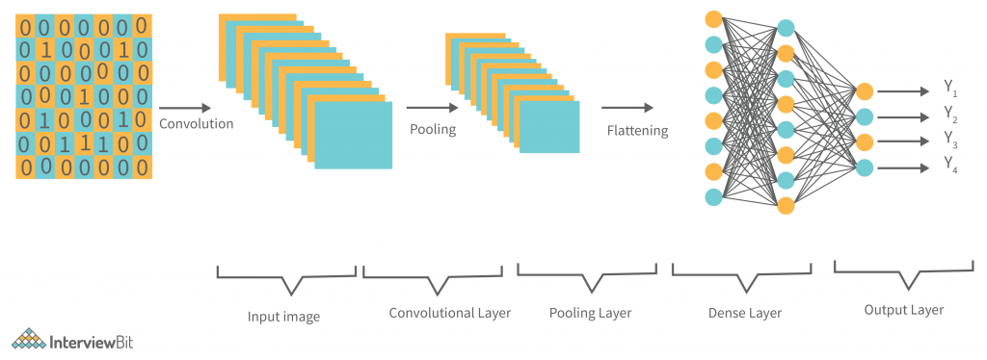
Layers of CNN:
Convolution Layer
Applies filters to extract image features ,Detects edges, corners, textures
Pooling Layer (MaxPooling)
Reduces image size to speed up computation Keeps important features only
Flatten Layer
Converts 2D data into 1D vector Prepares for fully connected layer
Fully Connected (Dense) Layer
Learns high-level featuresMakes final prediction (Mask / No Mask)

Slide 9
How It Works
Image Input : User uploads an image or starts webcam capture.
Preprocessing: Image is converted to NumPy array and resized if needed.
Model Loading:YOLOv8 model is loaded (yolov8n.pt for lightweight, fast detection).
Object Detection: Model detects objects and returns:
Bounding box coordinates
Class label (e.g., person, car, dog)
Confidence score
Result Display: Bounding boxes and labels are drawn using OpenCV.
Final result shown in the Streamlit app.

Slide 10
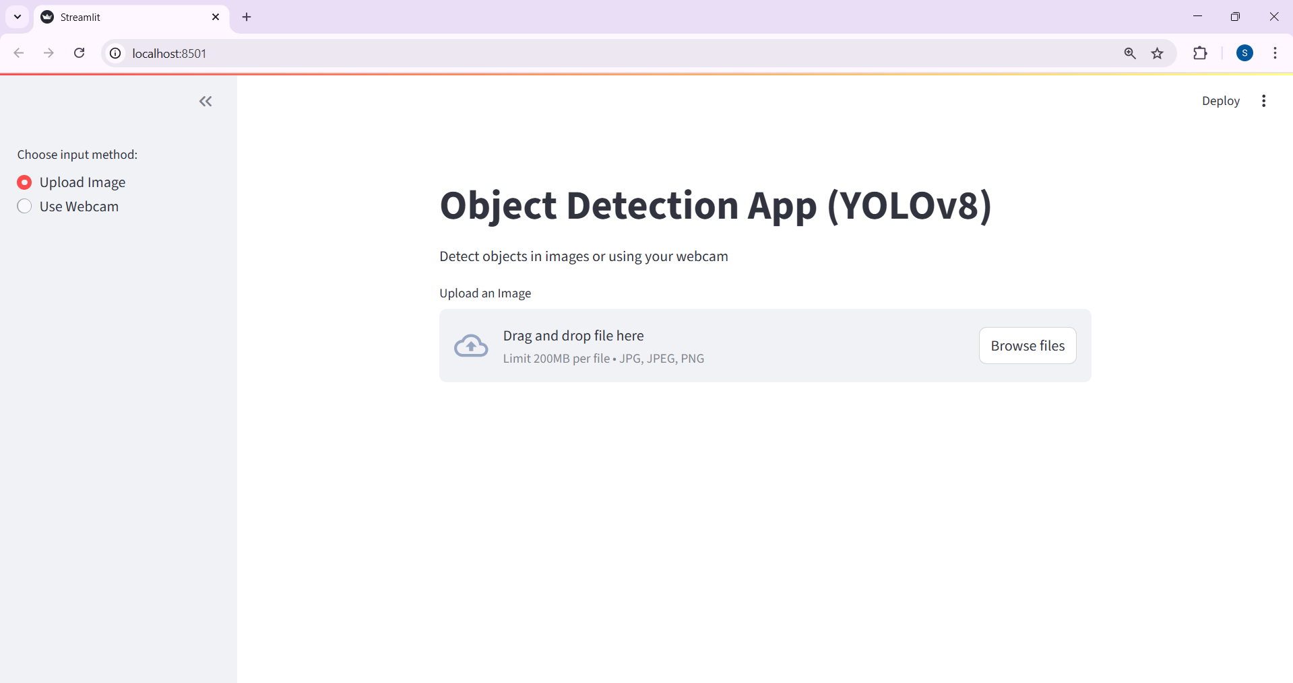

Slide 11
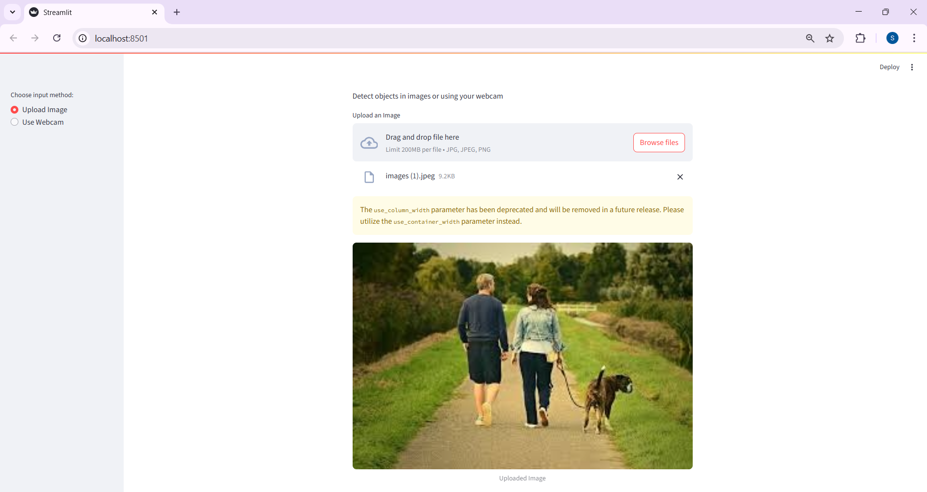

Slide 12
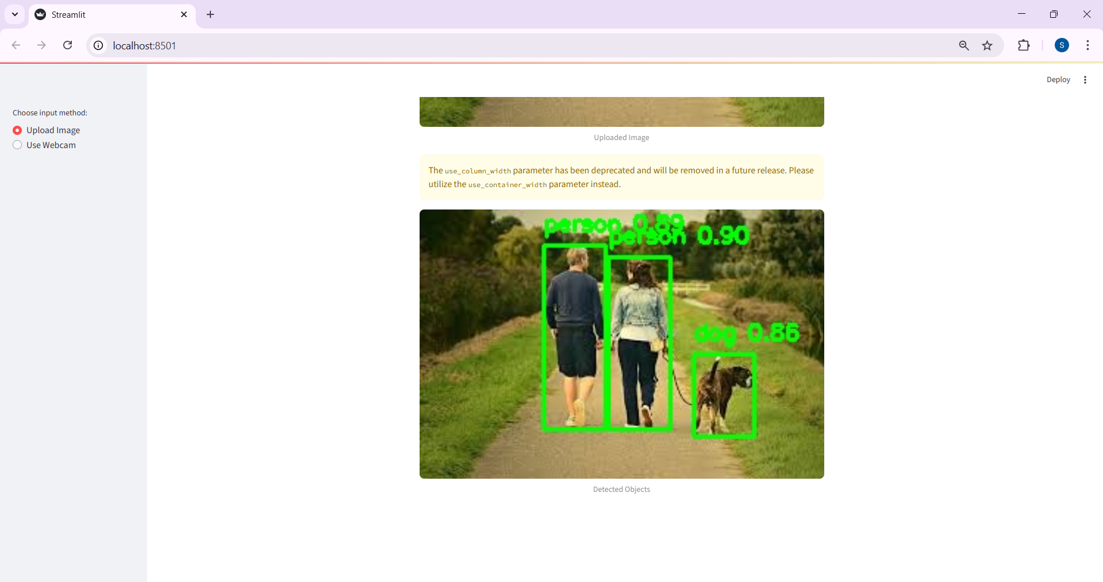

Slide 13
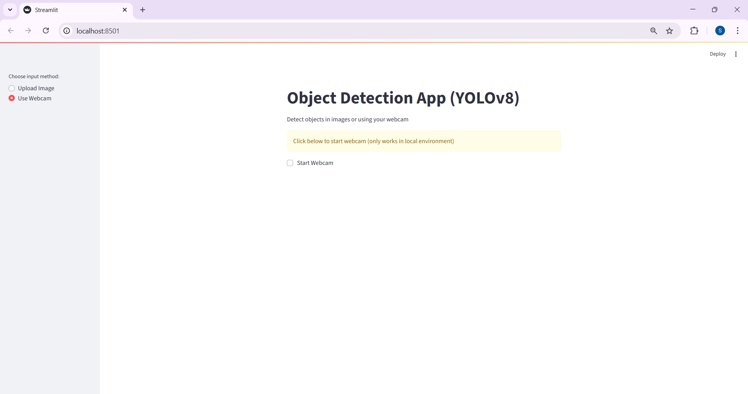

Slide 14
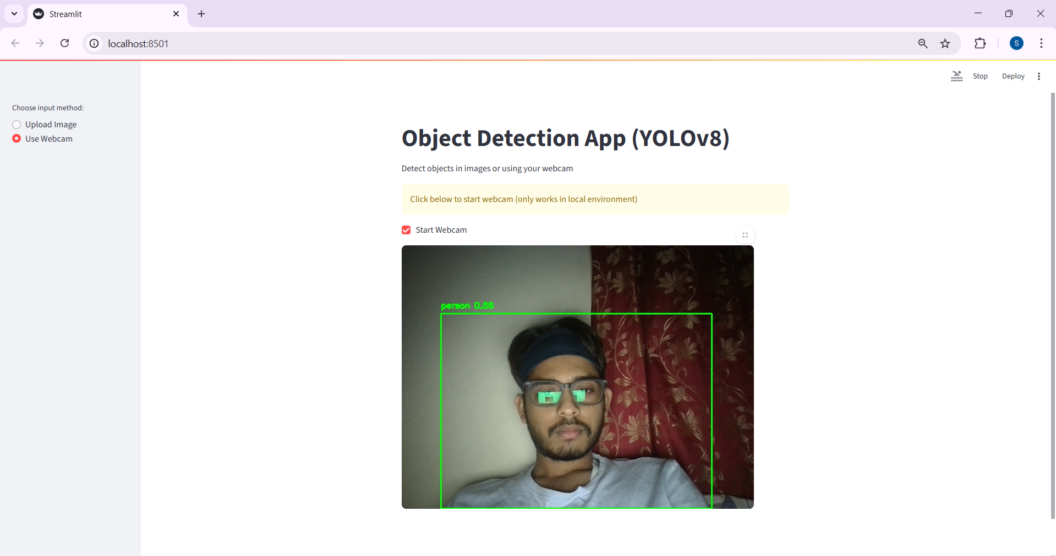

Slide 15
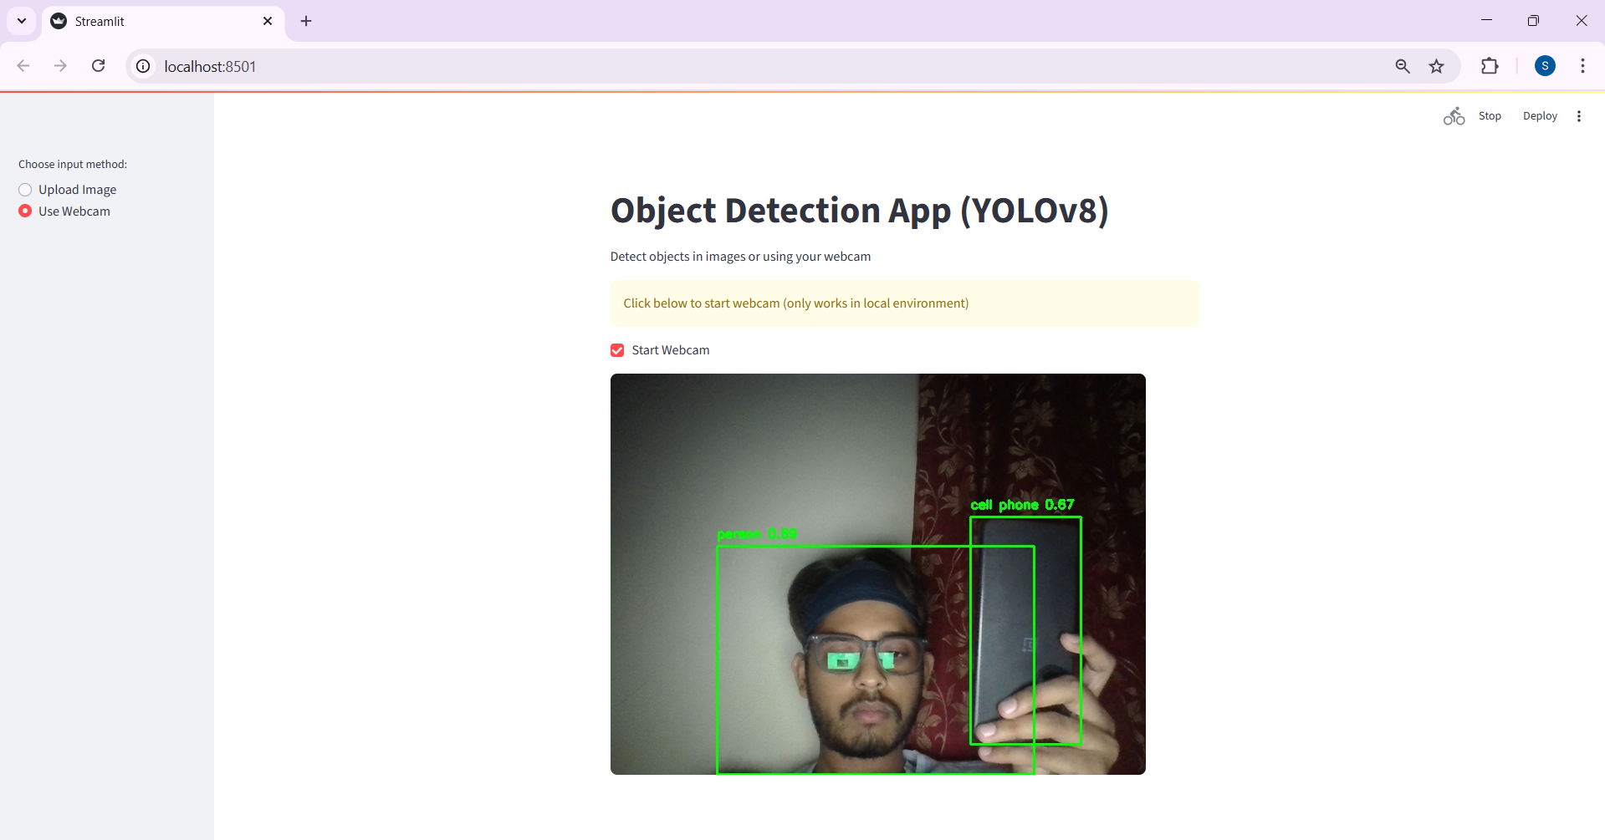

Slide 16
Future Work
Smarter Detection Train the model on custom datasets like helmets, fire, trash types, or safety gear for industry-specific applications.
Real-Time Surveillance Deploy on CCTV systems for real-time monitoring in schools, streets, or factories.
Pocket-Sized AI Convert the project into a mobile app that detects objects instantly using your smartphone camera.
Cloud Brainpower Host the model on AWS, GCP, or Azure to create a global detection API for smart cities.
Analytics Dashboard Track detection stats (count, confidence, categories) with an interactive Streamlit dashboard.
Robotics & Drones Use object detection to power robots or drones for smart delivery, inspection, or disaster response.
Social Impact Apply in public safety, environmental monitoring, or healthcare for real-world change.

Slide 17
Conclusion
We built a smart and efficient Object Detection System using YOLO + Streamlit – capable of detecting real-world objects/images in real time.
From uploading images to live webcam detection, the app offers a smooth, interactive experience powered by Deep Learning.
This project reflects the practical impact of AI in fields like security, automation, and smart surveillance.
It opens doors for future innovation — mobile deployment, cloud hosting, and integration with IoT devices.
With this project, we move a step closer to a world where machines understand the environment — faster, smarter, and safer.

